Slide 1
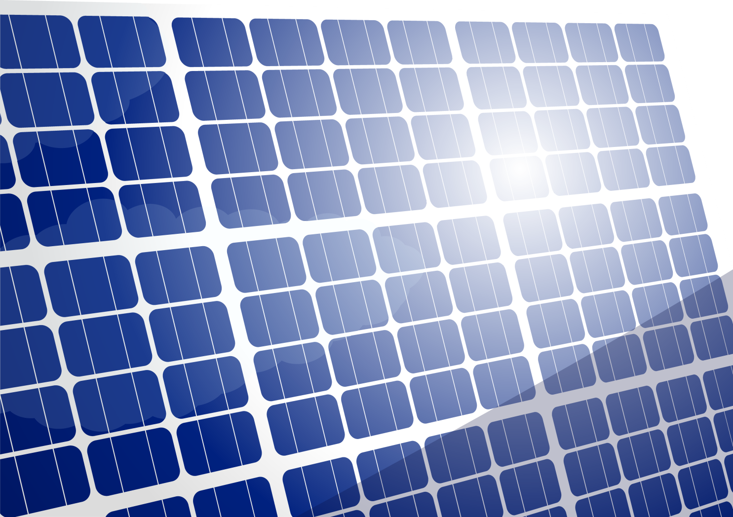
Blackberry Solar Cell
Questions in Context:
Do you remember something better when you are asked to think about it?
On the right, in the conversation bubble outlined in yellow, are guiding questions that you should ask the students during the associated step.
Each question should be asked separately – and a short amount of time should be allowed for responses.
Steps, Content & Hints
Main directions and content for the activity are in the boxes to the left with the orange border, like this one.
In a classroom setting, you will lead the students through the activity with a series of questions, the students’ own responses and brief explanations.
Whenever possible, find and affirm what’s right about the students’ answers.

Slide 2
Green Chemistry Introduction:
Defining Green Chemistry
Have students work in pairs for 30 seconds to come up with a definition for green chemistry. Break down the meaning of both words.
Establish that Chemistry is the science of making products.
Eco-friendly, good for the environment, sustainable.
What is Chemistry? What does chemistry mean to you? Do you think of good things or bad things? Who has heard of companies going green? What does that mean?
Green chemistry is pollution prevention at the molecular level, the basic design stage. So what is it that chemists do?
What do Chemists do?
Use wait time . Build off of their prior knowledge. Acknowledge student responses and prompt them for more information. Control the conversation by asking for a certain number of answers.
Chemists are inventors. They help to design just about every product out there.
Traditionally chemists were not taught about the environmental impact or toxicology. We have had many advances and helpful inventions but we have also had inventions that have caused harm to the environment. Green chemists design products taking into account the entire process, energy efficiency, renewable resources, the product itself along with the end-of-life impact of the product.
Is there anything in this room that a chemist invented? What about the desks, paint, floor, etc.
Who has taken medicine? Does anyone use an iPod or an mp3 player? What about a computer or a cell phone?
Would you buy a “traditional” cleaner that costs $1 or a “safer” cleaner that costs $5 for the same bottle size?
Would you buy a “traditional cleaner” that cleans well, or a “safer” cleaner that leaves streaks behind?
Green chemists think about safety, cost and performance in their product design
Set the Scene:
Connect the Dots & Introduce the Activity Topic
Connect the dots for them: they are the future scientists who will help to discover and invent solutions to our environmental challenges.
Introduce the 3 criteria of Green Chemistry:
Safety, Cost and Performance.

Slide 3
As green chemists today you will create your own solar cell. What do you know about solar cells? Tell me anything you know. Where have you seen them?
What are some good things about solar power?
Does anyone know any of the challenges?
What is a solar cell?
Simply a device that uses light energy from the sun and converts it into energy we can use – electrical energy (electricity).
Introduce Solar through Discussion:
Highlight advantages of solar: renewable resource, energy independence.
Highlight disadvantages: energy intensive production, hazardous chemicals used in the refining process of silicon and cost.
Review Experiment Safety:
“You are conducting an experiment today so please remember the rules of no eating or putting hands in your mouth. We ask that you wash your hands after the experiment.”
Let’s get started!
Who can tell me what is in the dish? Why do we need a blackberry to make a solar cell? Beach analogy: white vs. dark colors
What are we doing to the white strip? Why?
Who likes powdered donuts? The same ingredient found in toothpaste, white paint and powered donuts is titanium dioxide .
Is TiO2 safe? What about cost?
TiO2 is not being used for its whitening abilities but its semi-conductive properties.
1. Use the spatula to crush the blackberry and
extract the juices.
2. Remove the glass slide with the white coating (TiO2) from its bag.
3. Demonstrate how to handle the glass slide by the edges.
4. Place the TiO2 slide face down into the blackberry juice. (Allow to sit for 3-5 minutes)
5. Remove the transparent (ITO) slide from the bag and place it on the paper towel. (indium tin oxide)
6. Determine which side the coating is on by using the mulitimeter on the resistance setting Ω (Ohms). A non-zero reading indicates the coated side.
7. Using the tip of a graphite pencil lay down the carbon catalyst by shading the ITO coated side of the slide. There may not be any visible markings.
Each slide has been coated with ITO. ITO is a conductor. What is a conductor?
When we think about electricity we use the terms conductor, insulator, semi-conductor.
What is the tip of your pencil made of? What is graphite made of? Carbon is it inexpensive, safe?

Slide 4
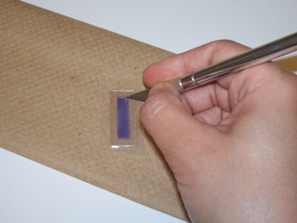
8.Remove the TiO2 from the blackberry juice using the spatula or fingers. Dry the slide using the paper towel by gently blotting the juice. Do not wipe or remove any of the dyed TiO2. (Check each set-up and be sure the slides are dry.)
Has anyone used saran wrap? Parafilm is the scientist saran wrap.
Why do we need to create a tight seal?
Is parafilm a conductor or an insulator?
We are cutting the parafilm out to create a well for our solution.
9. Ask students to locate the parafilm. Instruct them to remove the white paper backing and place the parfilm on top of the dye coated TiO2 slide.
10. Ask students to using their finger tips to press around the edges of the purple rectangle to adhere the parafilm to the slide.
Good time to reinforce the 3 criteria.
How is this process different from traditional solar cells?
What makes this an example of green chemistry technology?
11. Walk around to each group and cut out the rectangle area of the parafilm that sits on top of the TiO2 using an exacto knife . (as seen in the picture below)
12. Students will reinforce the parafilm seal around the edge of the TiO2 area.
Who has heard of the electrolytes before?
Has anyone had Gatorade?
With engaged high school groups have them read the bottle to identify the compounds in the solution.
Tri-iodide solution continuously frees up an electron in the process.
Iodine is used as an anti-septic. Propelyne gylcol is known as the “greener” anti-freeze. Emphasize the small amount needed to cost and safety .
Briefly discuss the iodide electrolyte solution. Pass out the dropper bottles for groups to share.
14. Place ½ drop of the iodide electrolyte solution in the middle of the dye coated TiO2 slide.

Slide 5

15. Demonstrate this step (using props or drawing on the board). Place the ITO slide on top of the TiO2 slide so that the conductive sides face each other.
16. Stagger the slides so that the entire TiO2 area is covered but a gap remains on either end.
Remind them that the conductive sides must be touching for electricity to be produced.
The gap or the steps are there to connect the circuit.
Electrolyte
with I⁻/I₂
Catalytic layer to promote
I⁻ to I₂ regeneration
Sensitizer Dye
Clipping the binder clips works best when one partner hold the slides together while the other puts the clips on.
TiO₂ Semiconductor
ITO electrode
Insulating Seal
17. Use the binder clips to hold the sides together, attach the clips to the long ends. Again remember to demonstrate this step or draw it on the board.
What are the 3 criteria for green chemistry technology again?
What does the solar cell need to work?
Depending on time take students outside to test solar cells. Otherwise pass out flashlights. Students can also place solar cells in the window for a comparison.
Acknowledge they have just assembled a dye sensitized solar cell using green chemistry technology.

Slide 6
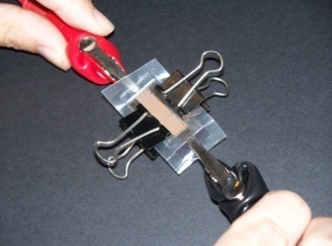
19. Push back the parafilm and affix the multimeter probes on opposite ends of the solar cell. Refer to picture below.
Remember to have the multimeter on the V (voltage)setting. Readings will vary and sometimes be erratic. Turn the multimeter off and try again. Using the alligator clips will help to stabilize readings.
Measurements are taken in millivolts. How many millivolts are in a volt? We will calculate the class total for millivolts.
Identify one person to write the measurements of the entire class on the board.
20. Ask one student per group to hold the flashlight and the other student to turn the multimeter to the voltage setting when you get the probes in place.
During this downtime as you go from one group to another ask students to brainstorm at least three variables in the experiment.
Additionally ask students to explain why dye sensitized solar cells are considered green chemistry technology.
21. Let’s evaluate the performance of the solar cells. Did they produce electricity? Could we power an lamp?
How about a TV?
22. The performance still needs to be improved but already major gains have been made in terms of cost and safety? Who remembers items we used that were safe?

Slide 7
Great Job! Scientists ask questions and seek out answers. Who here asks questions about how products are made or why we have certain problems?
Reiterate the 3 criteria of safety, cost and performance. Build off of the students’ responses and remind them why the dye sensitized solar cell is an example of green chemistry technology.
Any questions?
Wrapping up is always a good time to talk a little more about why you are in the classroom, what you are studying, researching or pursuing as a career.
In closing:
Green chemistry provides the tools needed for creating solutions to environmental challenges.
As a green chemist you can be a part of the solution by inventing better technologies for the future. Also remember that you do not need to be a scientist to make a difference in this world. As an informed citizen you have the power to influence change with your decision making, voting power and purchasing choices.

